Slide 1


NUML Entrance TEST Application
Object oriented programming project by
Syeda Sara Amjad, Muhammad Hamza Mughal, Zain Ali, Laiba Batool, Kumail Abbas

Slide 2
Problem identification
Traditional Entrance exams require extensive logistical efforts for printing and distributing papers.
Manual grading is error-prone and delays result processing.
Security risks include potential loss, theft, or tampering of exam papers.

Slide 3
GUI
Interface vs Graphical User Interface.
Major Components of GUI used
Frames
Labels
Text-Fields
Combo Box
Buttons
Radio Buttons
Major Packages Imported
import javax.swing.*;
import java.awt.*;
import java.awt.event.*;

Slide 4
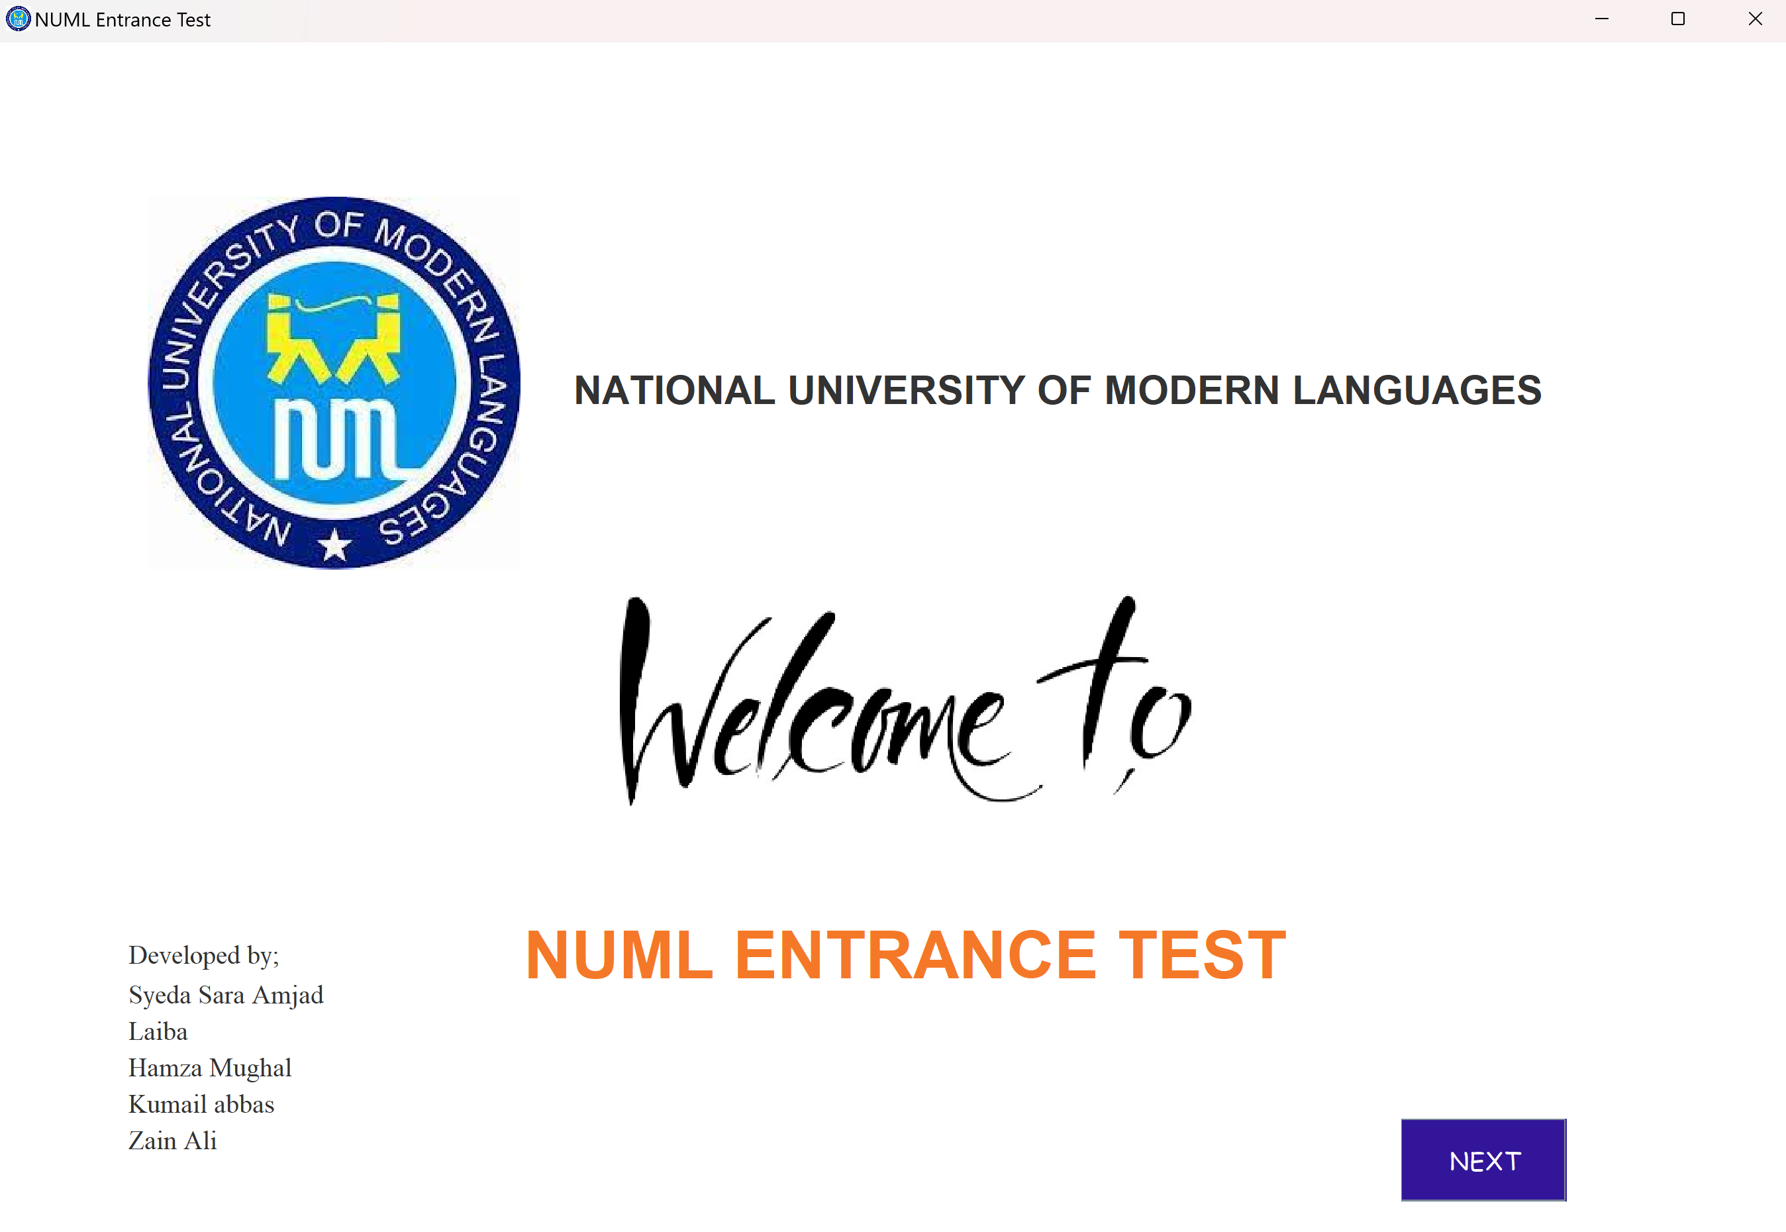
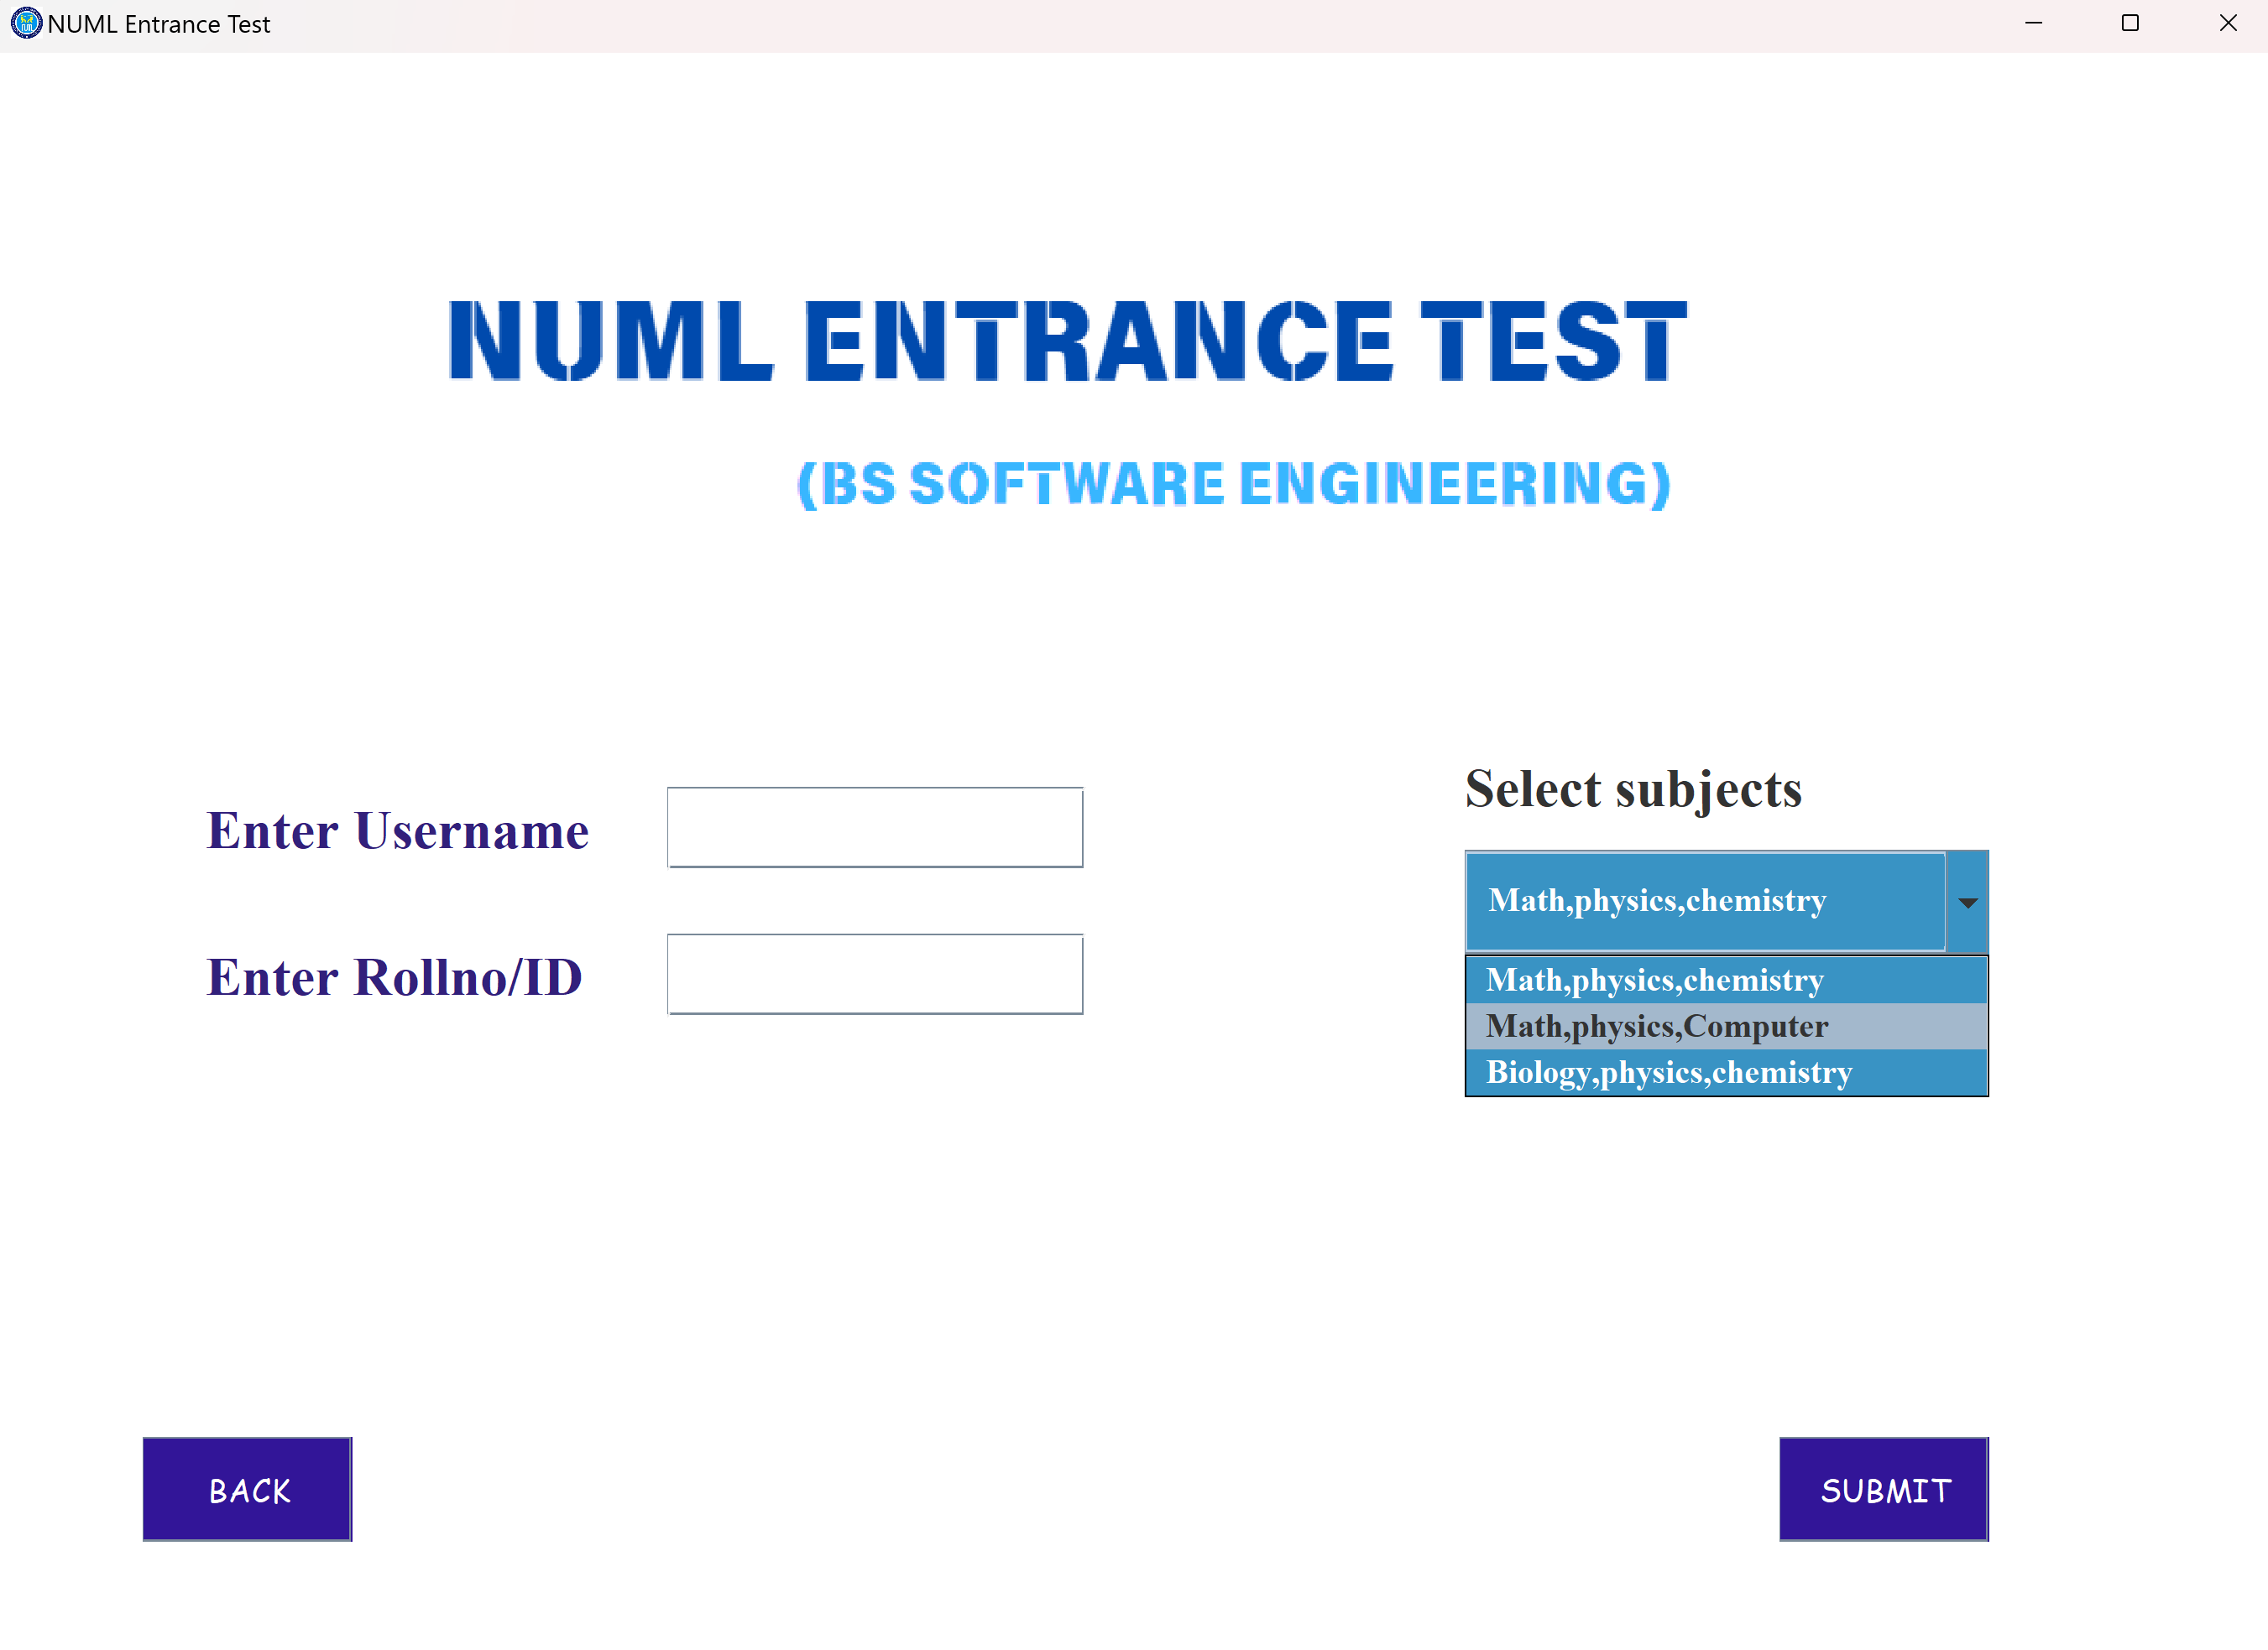
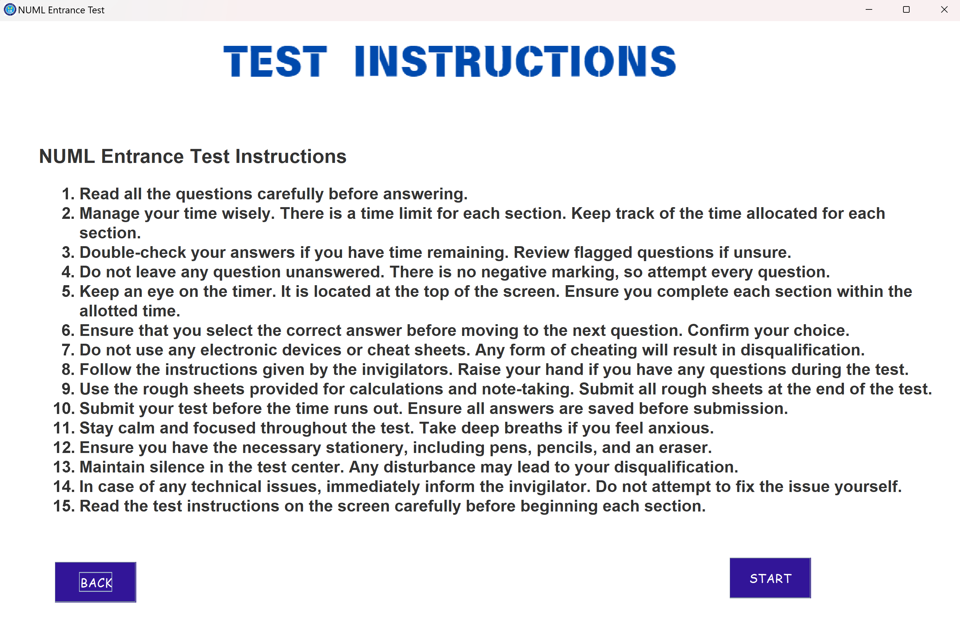
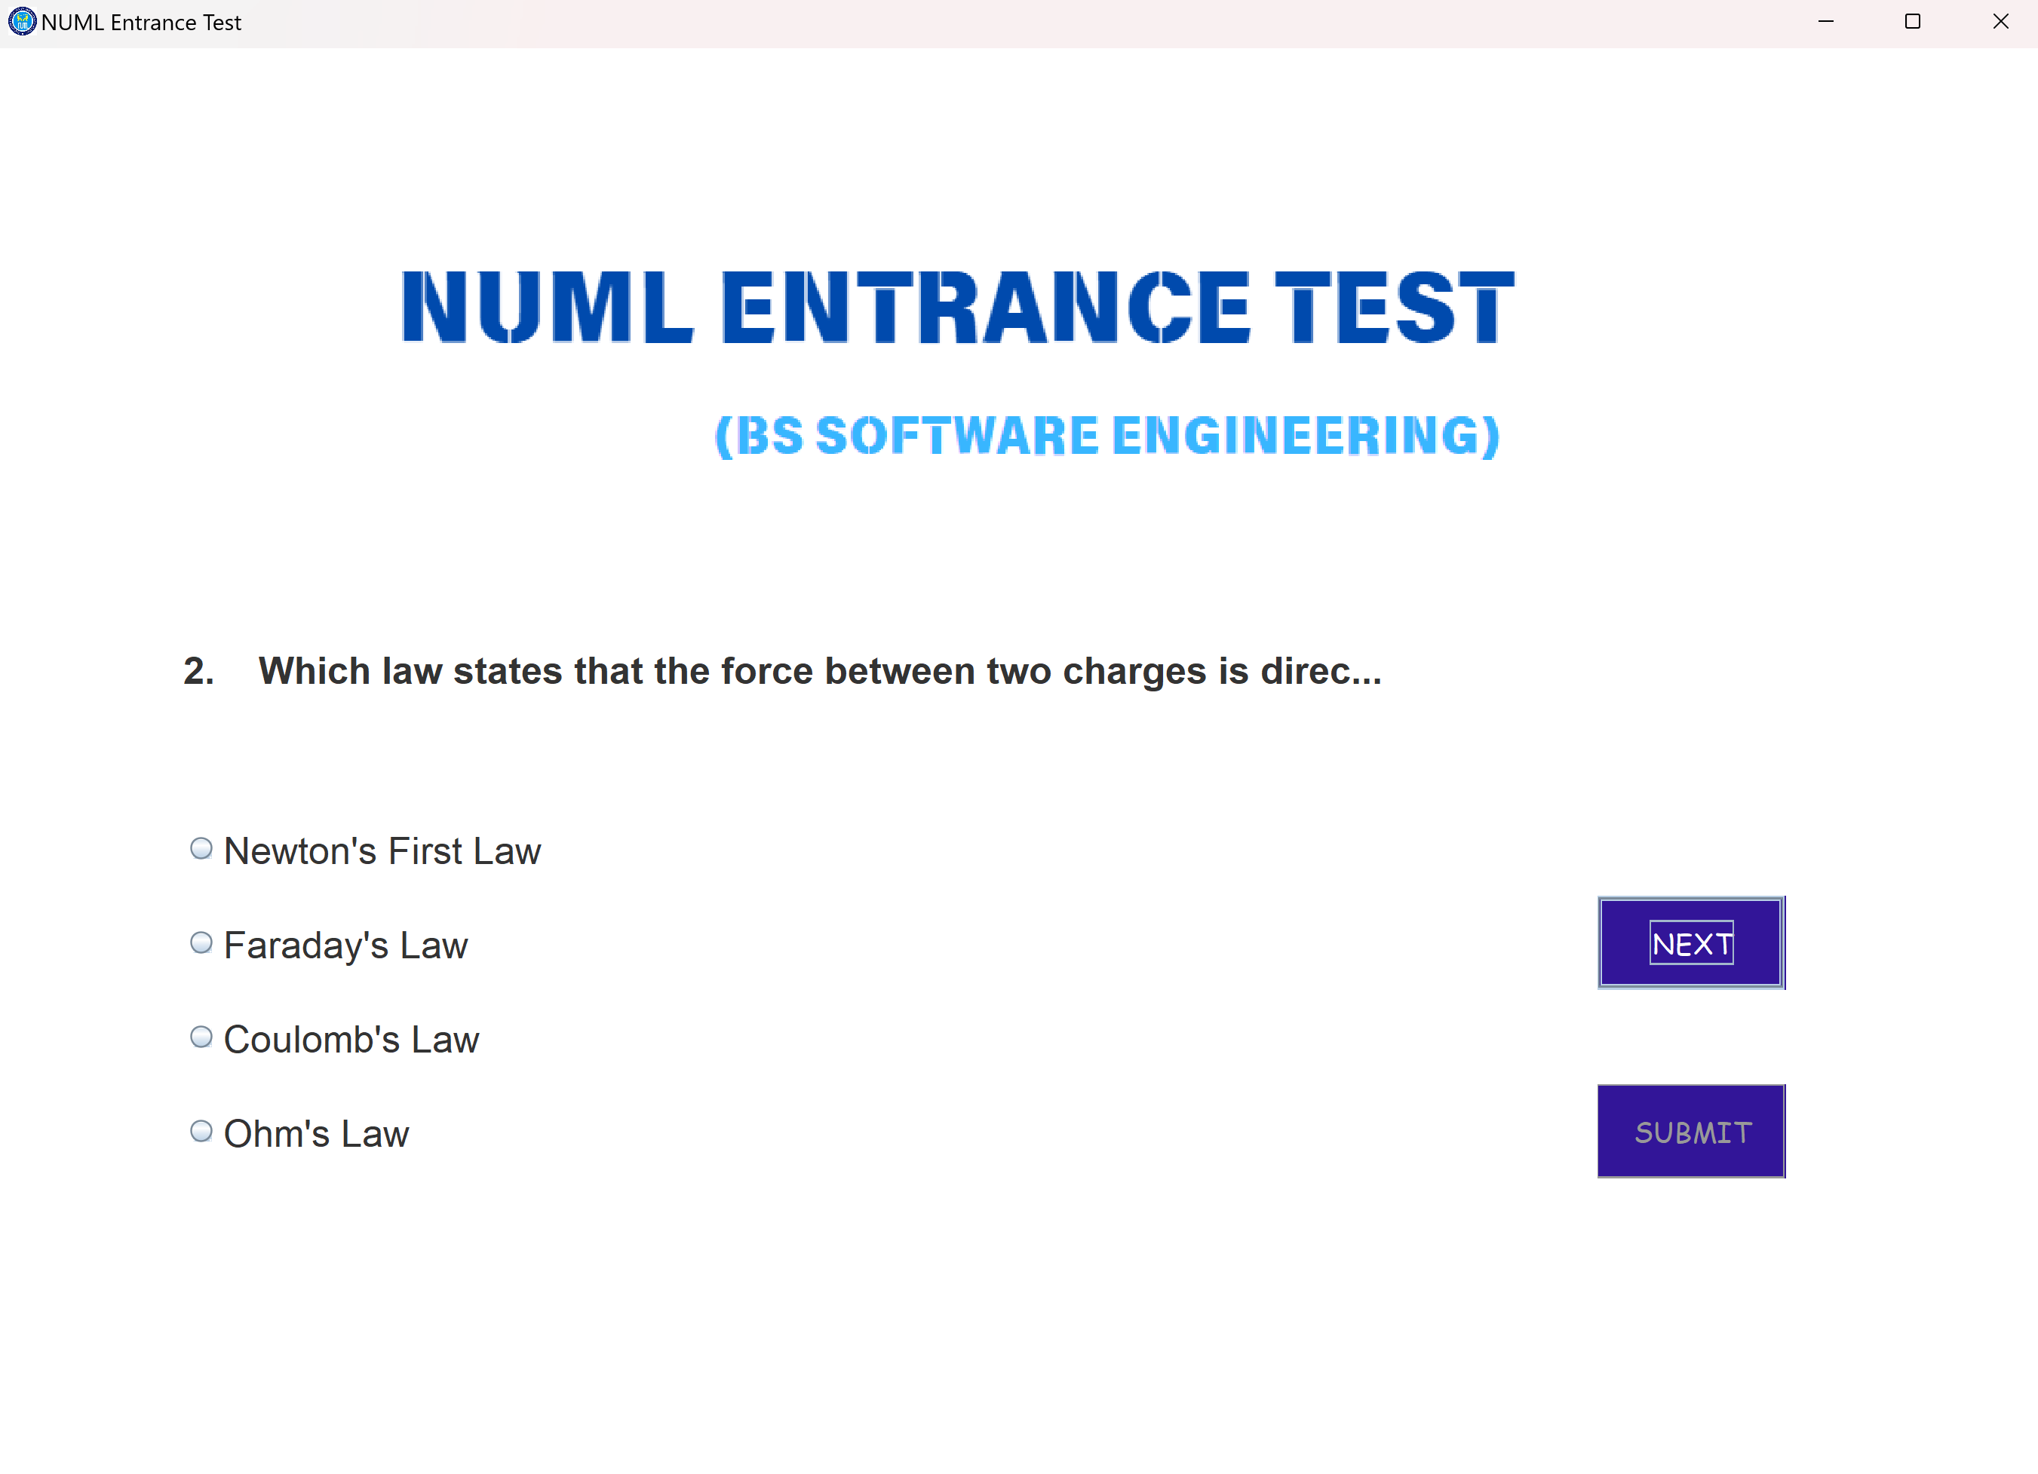
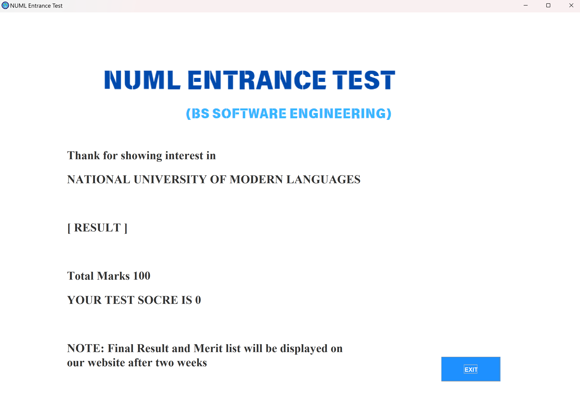
Screen 1
Screen 2
Screen 3
Screen 4
Screen 5

Slide 5
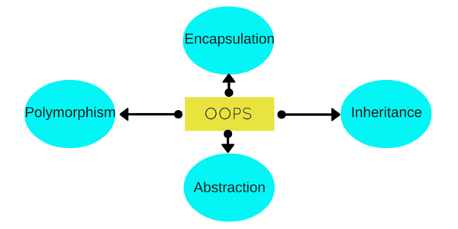
Pillars of OOP USED

Slide 6
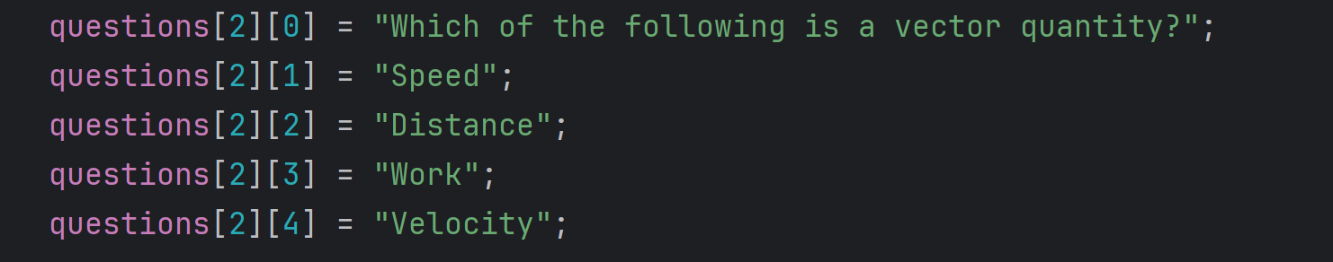
How we stored Mcqs?
Using 2D Array
String questions[][] = new String[10][5];
String answers[][] = new String[10][2];
How we check correct answers?
By comparing the indexes of Qs array & Ans Array.

Slide 7
Area for improvements
We can increase number of questions.
by increasing the size of array.
We can add timer.
we can add timer for each question as well as for entire test
We can save the result with username and roll no.
by using database
We can generate percentile.
we can generate result of each candidate and by doi ng calculations we can find the percentage of the result

Slide 8
THANK YOU

